Slide 1

MENTAL HEALTH IN TECH SURVEY

Slide 2
Data Preprocessing Pre-processing refers to the transformations applied to our data before feeding it to the algorithm. Data preprocessing is a technique that is used to convert the raw data into a clean data set. In other words, whenever the data is gathered from different sources it is collected in raw format which is not feasible for the analysis.
Step 1: Remove duplicate or irrelevant observations Remove unwanted observations from your dataset, including duplicate observations or irrelevant observations. Duplicate observations will happen most often during data collection. When you combine data sets from multiple places, scrape data, or receive data from clients or multiple departments, there are opportunities to create duplicate data.

Slide 3
Step 2: Fix structural errors Structural errors are when you measure or transfer data and notice strange naming conventions, typos, or incorrect capitalization. These inconsistencies can cause mislabeled categories or classes. For example, you may find “N/A” and “Not Applicable” both appear, but they should be analyzed as the same category. Step 3: Filter unwanted outliers Often, there will be one-off observations where, at a glance, they do not appear to fit within the data you are analyzing. If you have a legitimate reason to remove an outlier, like improper data-entry, doing so will help the performance of the data you are working with. However, sometimes it is the appearance of an outlier that will prove a theory you are working on.

Slide 4
Step 4: Handle missing data You can’t ignore missing data because many algorithms will not accept missing values. There are a couple of ways to deal with missing data. Neither is optimal, but both can be considered. Step 5: Validate and QA At the end of the data cleaning process, you should be able to answer these questions as a part of basic validation: Does the data make sense? Does the data follow the appropriate rules for its field?

Slide 5
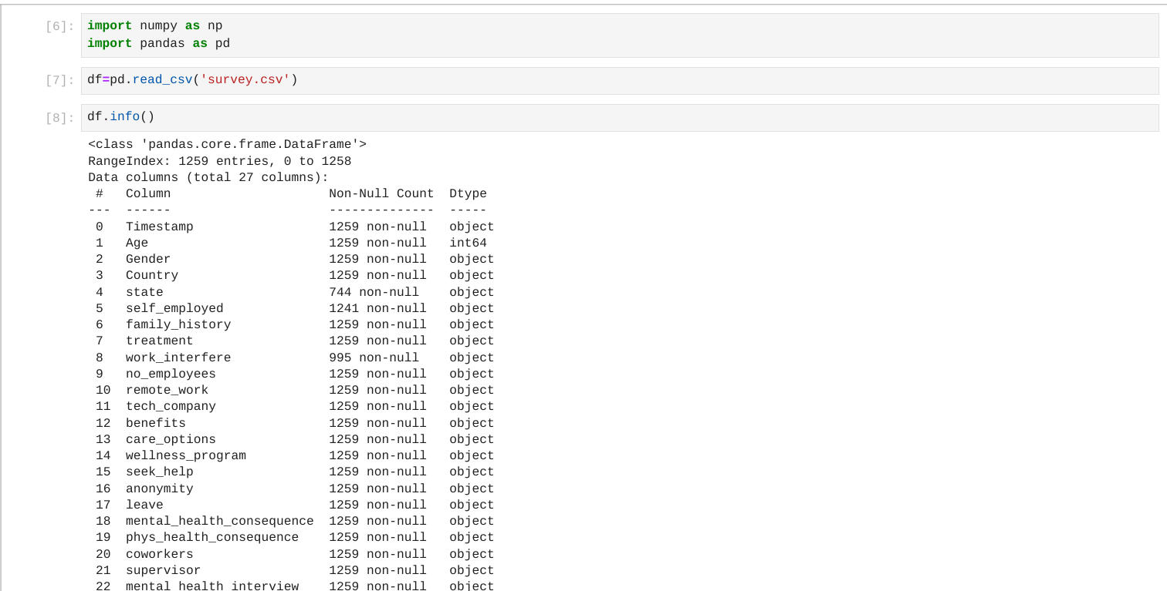
Importing the python libraries in jupyter noetbook(pandas,numpy)
Using pandas to read the dataset(Survey.csv):

Slide 6
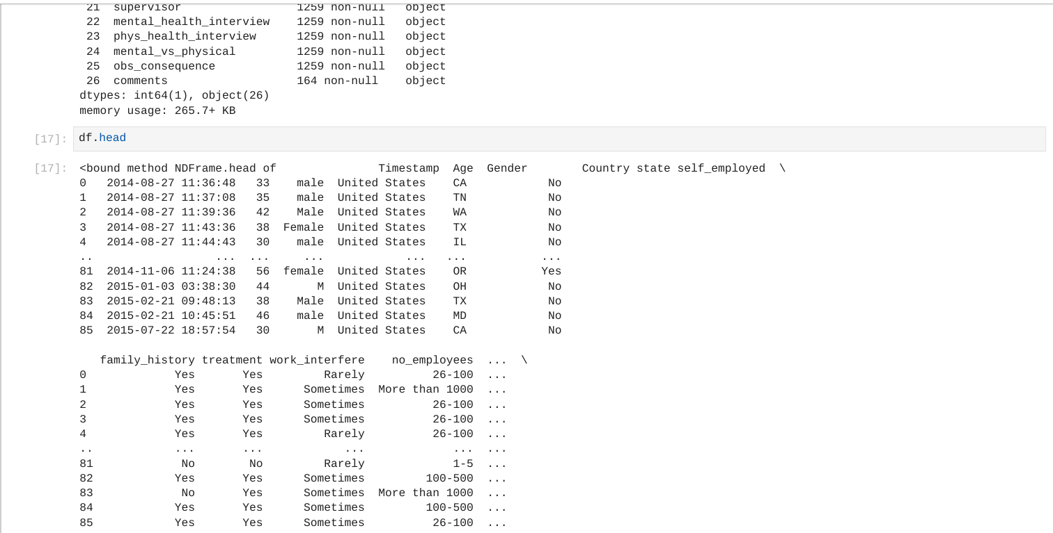
Using dataframe to verify the header of dataset

Slide 7
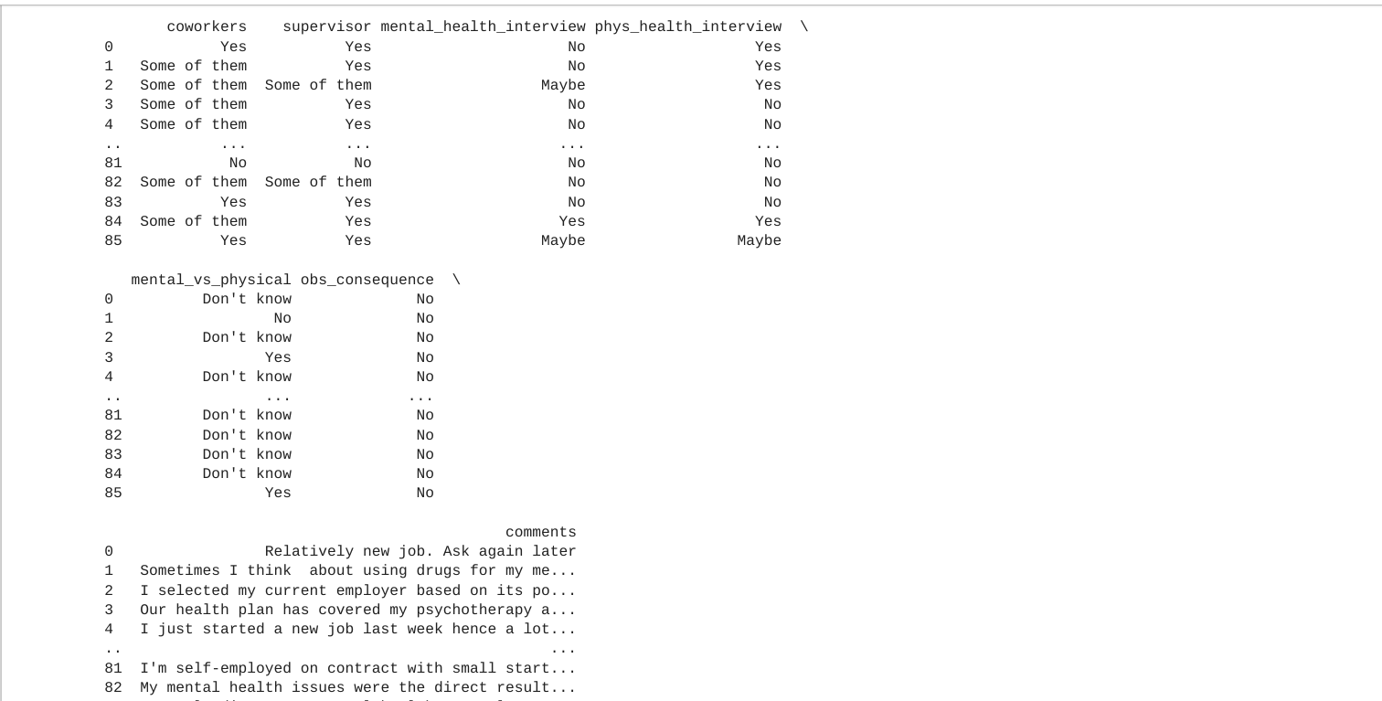

Slide 8
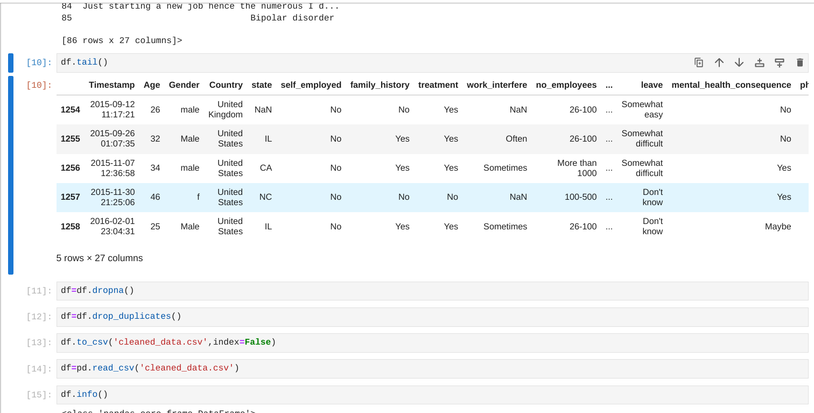
Cleaning the dataset using dropna method and saved the dataset in 'cleaned_data.csv'

